Slide 1

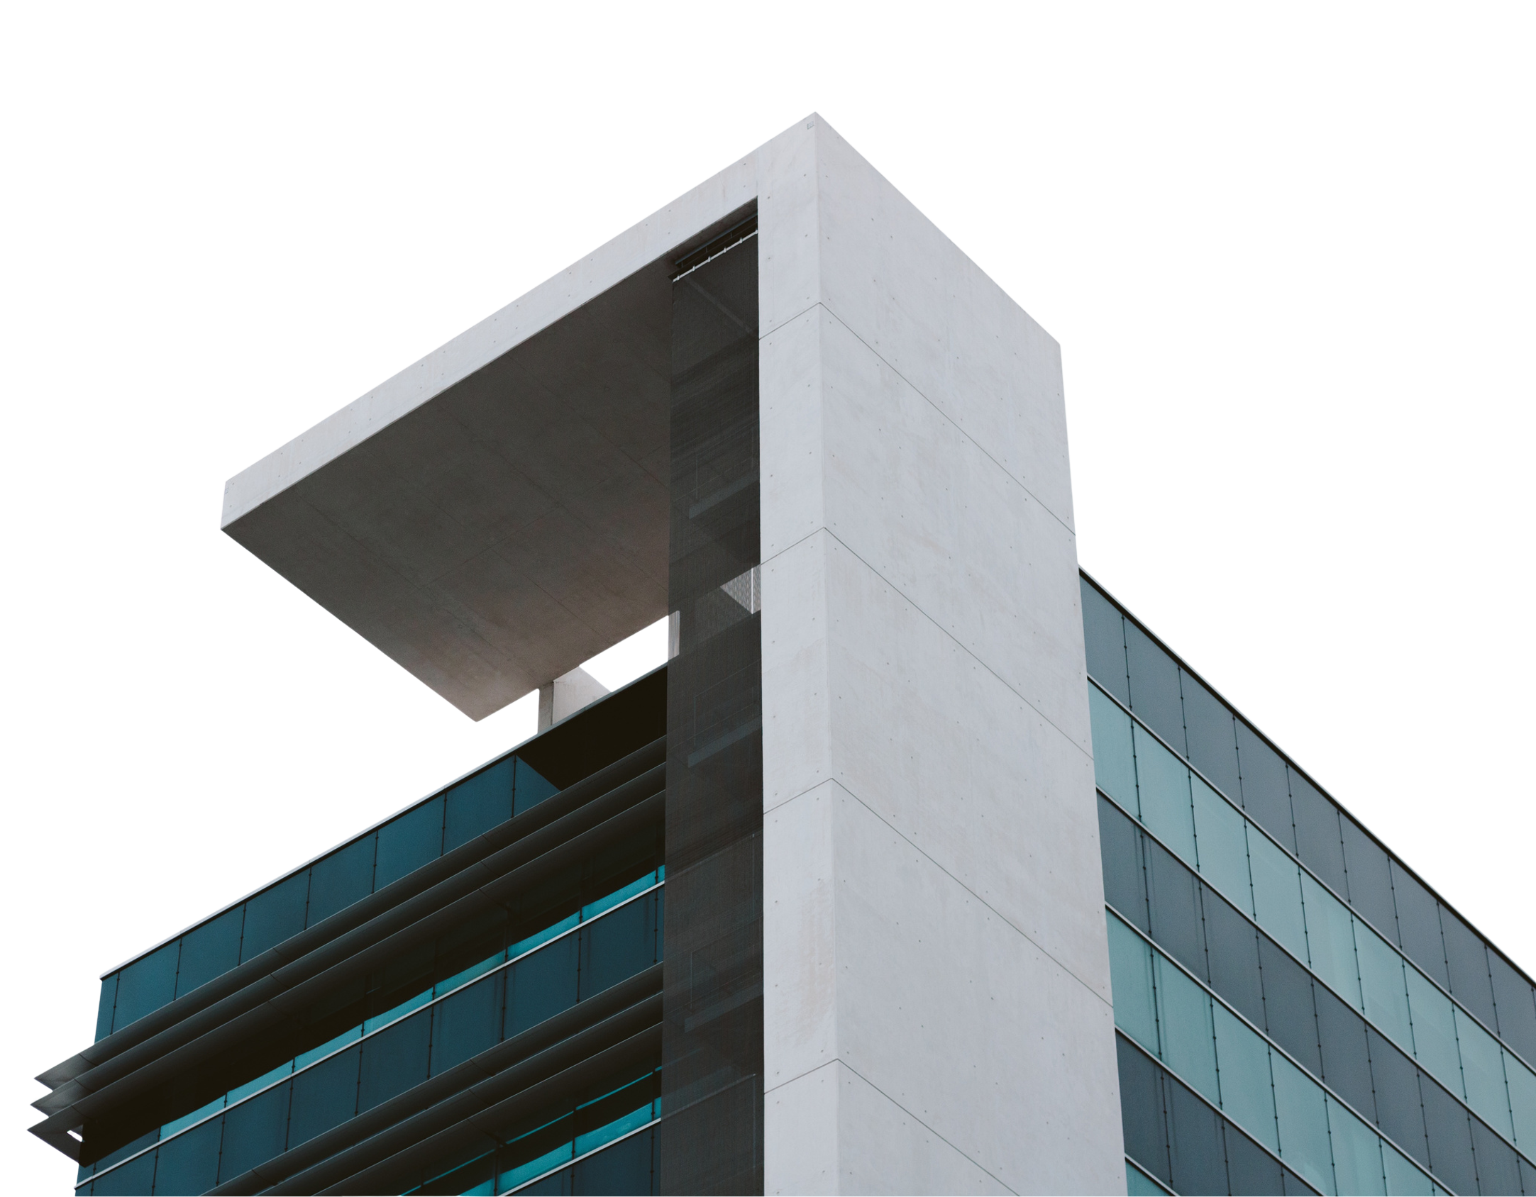




Opportunities
In the Nigerian
Real Estate Sub - Sector
CHUDI S. UBOSI FNIVS

Slide 2




INTRODUCTION
Real estate is an asset class that is very popular world wide.
It is dynamic and a multi trillion Naira industry from Lagos to Maiduguri and from Calabar to Kafanchan.
The Nigerian real estate sector is driven by rapid urbanization, an exploding middle and upper middle class and poor infrastructural development.
Despite all these the sector comes with its own challenges, poor power supply, poor road networks, sanitation and services deficiencies etc.
One of the largest challenges of the sector is the regulatory and legal issues. The Land Use Act of 1979 is forty-seven years old and has outlived its usefulness.
Other regulatory issues in real estate range from over regulation and a source of revenue in States like Lagos to poor regulation and absent oversight in other states.

Slide 3






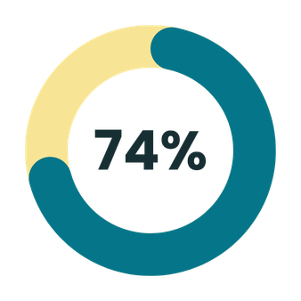

THE NIGERIAN REAL ESTATE SECTOR
Nigerian population
Growth rate
200M
3.89%
An Overview
per annum
Approximately 55% of the Nigerian population is between the age of
55%
Lagos
17.50m - 21m
16-60

Slide 4



Residential real estate holds market volume of $2trn.
Contributes 5% to the annual GDP.
Housing deficit - 20 million units
Need to build 550K - 700K annually to begin to close the gap.
More of – 2 – 3 bedroom flats - (Needs pyramid)
Land area 927,000 sq kilometres.
Less than 10% is titled.
Majority of the titled properties are in Abuja and parts of the South West.
The figures represent a large population that needs housing.
Percentage of accommodation fit for living 30%
70% live in informal settlements, slums or structurally inadequate housing.
By informal settlements and slums etc
Security tenure
Non availability of services – water electricity roads
Access to healthcare, education, employment
Affordable rents

Slide 5










OPPORTUNITIES
The previous paragraph which gave an overview leads to the opportunities in the sector.
The Chinese word for problem and opportunity are the same.
Where there is a problem therein also lies an opportunity.
Opportunities exist in every corner of the real estate sub sector and below are a few that can be examined.

Slide 6


Processing of title documents – Certificate of Occupancy
Only 10% of land in Nigeria is titled. It means that for every 10 houses that you see only 1 has valid title documents.
Purchase receipt
Survey plan
Equitable interest
Dead capital
Title frees up your capital and allows you to apply your funds in other activities.
Learn a Skill
Tiler
Plumber
Electrician
Today most of the artisans in Nigeria are from the West Coast. Reliability, Commitment, stability.
Student Housing
Getting on the property ladder
Set up an investment group
Set up an SPV buy, hold sell
Renovation – up grading real estate to UN Standards.
Speculation - Coastal Road / Agbara – Sokoto Road.

Slide 7








For those with deep pockets, the large ticket transactions will always be there
Joint venture projects
Buy – develop - sell
Buy – renovate - sell
Buy - lease

Slide 8






The Nigerian real estate market presents a dynamic landscape of challenges and opportunities.
It requires creativity, hardwork, sacrifice, delayed gratification and a willingness to stay the course for long term gain.
No one can play in all fields and so each person must decide where he/she want to focus and give it all we have with the belief and faith that God will see us through.
Thank you for listening.
CONCLUSION

Slide 9
Thank You

